Slide 1
Other Types of Dislocations in FCC
Sessile or Frank Dislocations
These are immobile dislocations.
They appear under two specific conditions that are shown in Fig. 13-9.
Condition I (Intrinsic): A disk was removed in plane (111), as shown in Figure 13-9(a)
Condition II (Extrinsic): A disk was added in plane (111), as shown in Figure 13-9(b).

Slide 2
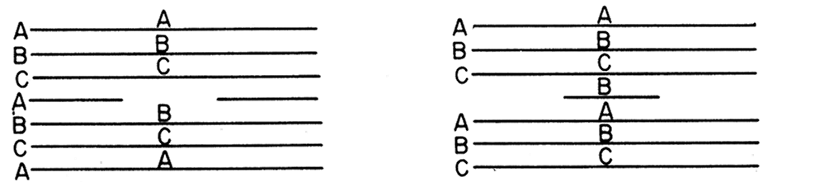
(a)
(b)
Figure 13-9 (a & b). A Frank partial dislocation or sessile dislocation.

Slide 3
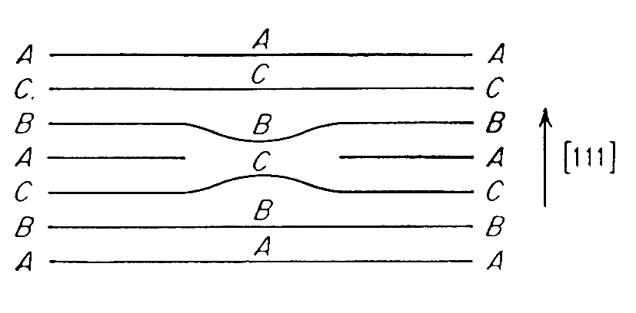
Figure 13-9 (c). A Frank partial dislocation or sessile dislocation.

Slide 4
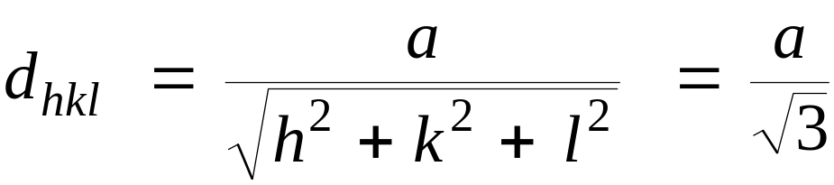
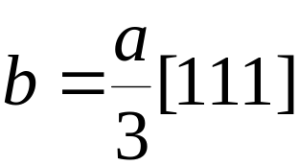
It can be seen that in both cases the stacking sequence was changed from ABCABCABC to ABCBCA and ABCBABC for Fig. 13-9, respectively.
The magnitude of the Burgers vector is determined by applying:
The Burgers vector is expressed as:
(13.6)

Slide 5

In Thompson’s tetrahedron Figure 13-10, the Frank dislocations are represented by
Since the Burgers vector is not in the slip plane, they are immobile.

Slide 6
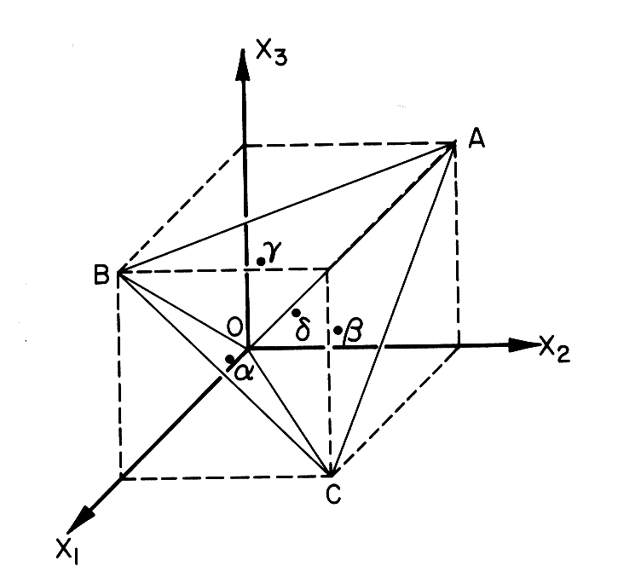
Figure 13-10(a). Thompson tetrahedron, the vertices are points (011), (101), (110), (000),

Slide 7
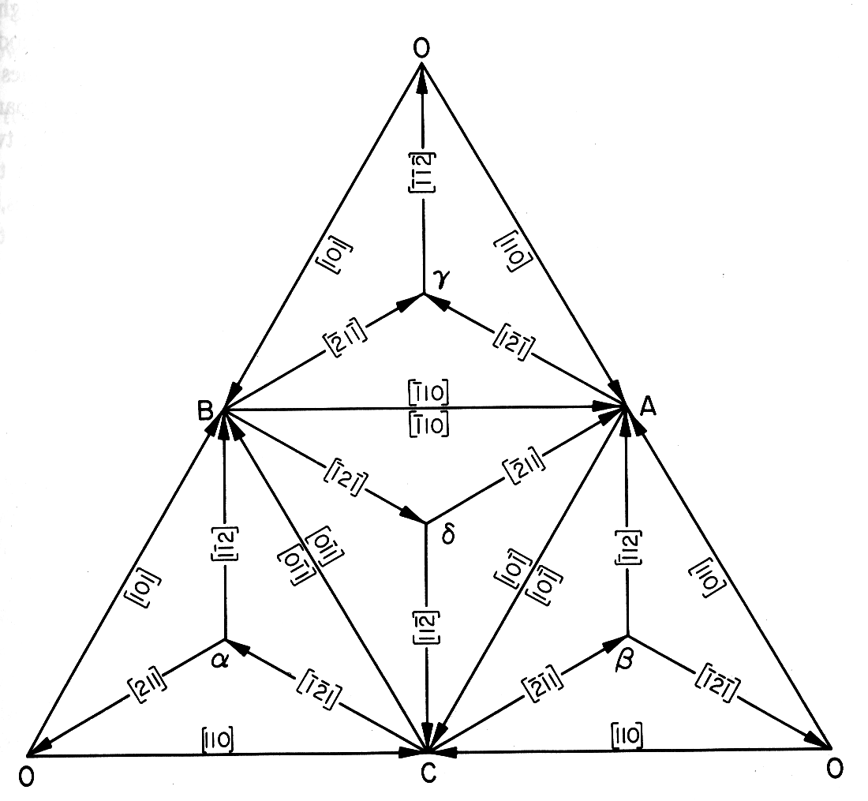
Figure 13-10(b). Thompson tetrahedron, with all dislocations indicated.

Slide 8


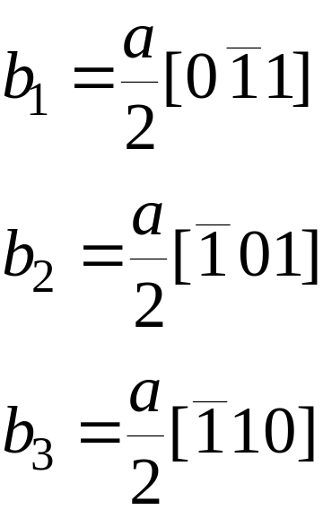
Lomer-Cottrell Lock
Another type of immobile dislocation that can occur in FCC metals is the Lomer-Cottrell lock.
Let us consider two (111) and planes that are represented by , respectively, in Thompson’s tetrahedron of Figure 13-10.
The three perfect dislocations in (111) are

Slide 9

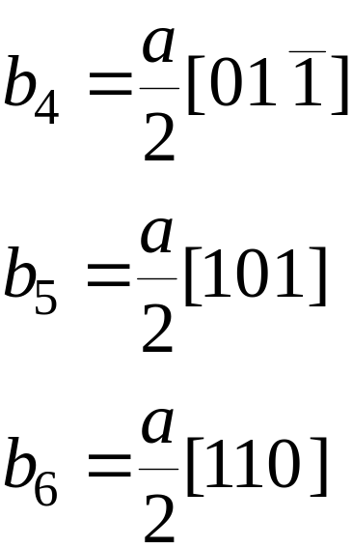
For plane , the dislocations are:
One good rule to determine whether a direction belongs to a plane is: the scalar product between the direction b and the normal to the plane has to be zero ( in a cubic structure). This rule comes from vector calculus.

Slide 10
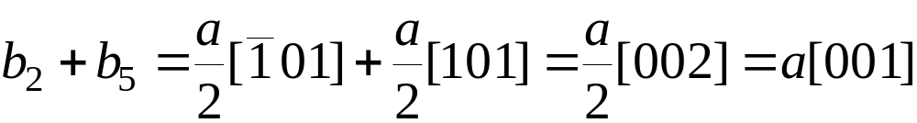
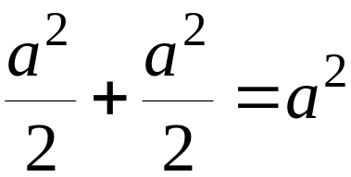
b₁and b₄ have the same direction and opposite senses; the common direction is also that of the intersection of the two planes. Hence, both dislocations will cancel when they encounter each other.
The combination of b₂ and b₅ result in
The energy of these dislocations is:
Therefore, this reaction will not occur, because it would not result in a reduction of the energy.

Slide 11
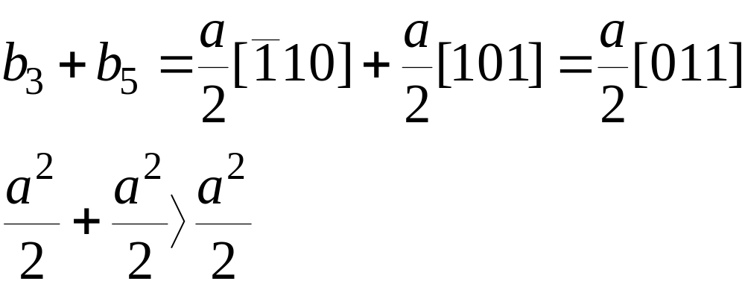
The sole combinations that would result in a decrease in the overall energy would be of the type:
This reaction is energetically favorable; it is shown in Figure 13-11.

Slide 12
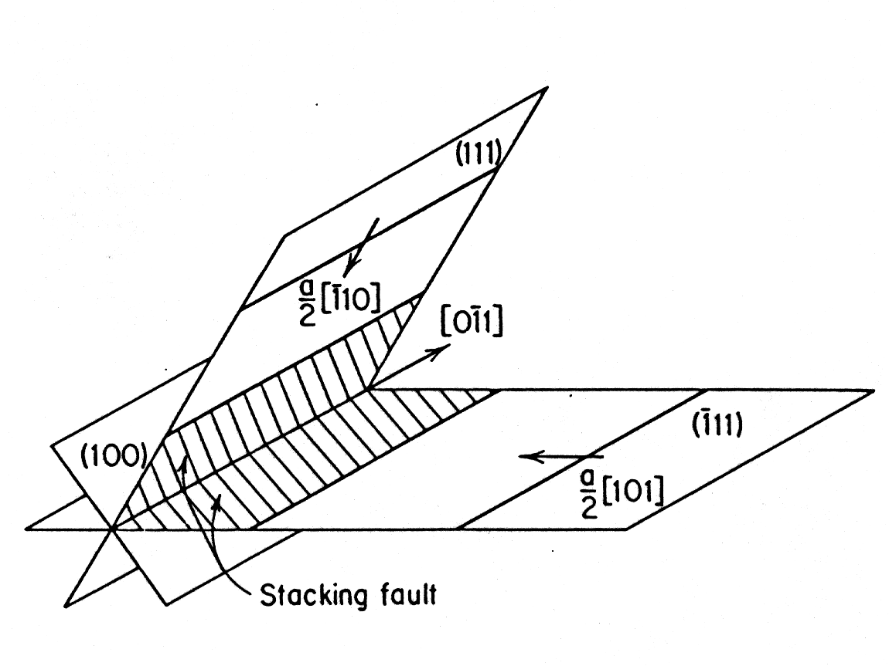
Figure 13-11. Lomer-Cottrell barrier

Slide 13
This dislocation is not mobile in either the (111) or plane ; hence, it acts as a barrier for any additional dislocation moving in these planes.
It impedes slip and is therefore called a “lock.”
It was initially proposed by Lomer.
Cottrell later showed that the same reasoning could be applied to partial dislocations ( also known as Shockley partials)

Slide 14
The resultant configuration is shown in Fig13-11; it resembles a stair and is therefore called “ stair-rod” dislocation.
The leading partials react and immobilize the partials coupled to them (trailing partials).
Its Burgers vector lying in the (100) plane normal to the line of intersecting so it is pure edge dislocation. Since (100) is not a close-packed slip plane in the fcc lattice, this dislocation will not glide freely.

Slide 15
The bands of stacking faults form a configuration resembling steps on a stairway.
These steps are barriers to further slip on the atomic planes involved, as well as in the adjacent planes.
The dislocation is sessile because its Burgers vector does not lie in either of the planes of its stacking faults.
However, it is not a true sessile dislocation in the sense of the Frank partial because it is not an imperfect dislocation.

Slide 16
Lomer-Cottrell barriers can be overcome at high stresses and/or temperatures.
However, it has been shown that for the important case of screw dislocations can escape the pile-up by cross slip before the stress is high enough to collapse the barrier.
While the formation of Lomer-Cottrell barriers is an important mechanism in the strain hardening of fcc metals, they do not constitute the chief contribution to strain hardening.

Slide 17
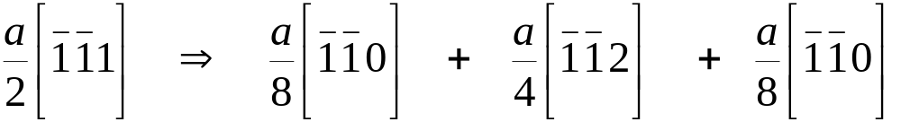
Dislocations In the Body-Centered Cubic Lattice
In BCC crystals the atoms are closest to each other along the <111> directions.
Any plane in the BCC crystal that contains this direction is a suitable slip plane.
Slip has been experimentally observed in (110), (112) and (123) planes.
The following reaction has been suggested for a perfect dislocation having its Burgers vector along <111>:

Slide 18
This corresponds to the equivalent of Shockley partials.
Apparently, the stacking fault energy is very high, because they cannot be observed by TEM.
The waviness of the slip markings is also indicative of the high stacking fault energy.
If the partials were well separated, slip would be limited to one plane.
Recall - Cross-slip is much easier when the stacking fault is very high.

Slide 19
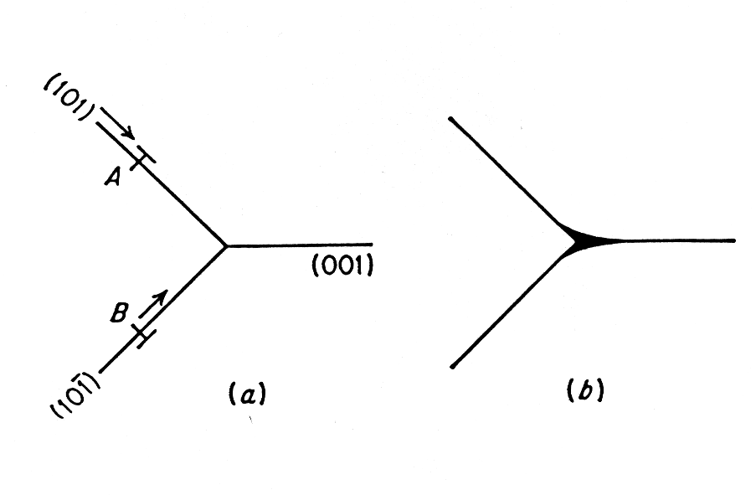
Dislocations In the Body-Centered Cubic Lattice
Figure 13-12 . Slip on intersecting planes.

Slide 20
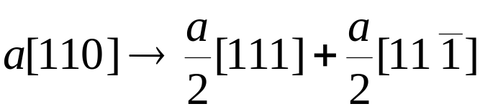
Example:
Show that a dislocation in a BCC structure with a Burgers vector equal to a <110> is energetically unstable and will split in to two a/2 <111> dislocations by the following reaction:

Slide 21

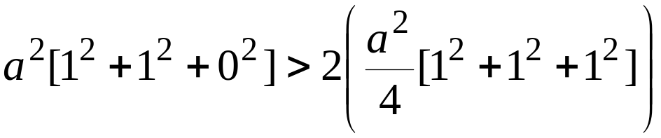
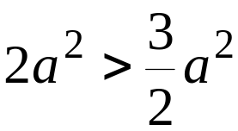
For the above reaction to take place the energy of the a<110> dislocation must be greater than the sum of the energies of two a/2<111> dislocations. Since the energy of a dislocation is proportional to , we require
or
The reaction is therefore energetically favorable.
Need to check the vector addition.

Slide 22
Example:
Consider the following body-centered cubic dislocation reaction:
(a) Prove that the reaction will occur.
(b) What kind of dislocations are the (a/8)<110> and (a/4)<112>?
(c) What kind of crystal imperfection results from this dislocation reaction?
(d) What determines the distance of separation of the (a/8)[110] and the (a/4)[112] dislocations?

